Slide 1

Online Project management, Task management, Team communication
By Group B

Slide 2
Group B Members
Tô Nhân Kiệt (Manager) - 1459026
Trang Trí Kiệt - 1459027
Lê Ngọc Quỳnh Như - 1459039
Châu Đức Hội - 1459020
Nguyễn Thanh Thế Vinh - 1459059

Slide 3
Brief talk about the seminar topic
_ In these years almost everything has been “digitizing”, computers and software play a major role in our work. Especially, now that one of the trending technologies is cloud-computing.
_ People are using online services, online tools to optimize the works and processes.
_ Many online Project Management, Task Management, Team Communication services are being presented in the market, offer many features and various in shapes.

Slide 4
Brief talk about the seminar topic (cont)
_ Our team is going to present about these 10 online tools/services:
Project Management:
Wrike (this one will have more details)
Taiga
Asana
Podio
Task Management:
Trello (this one will have more details)
Quire
Meistertask
Team Communication:
Slack (this one will have more details)
Skype
Glip

Slide 5
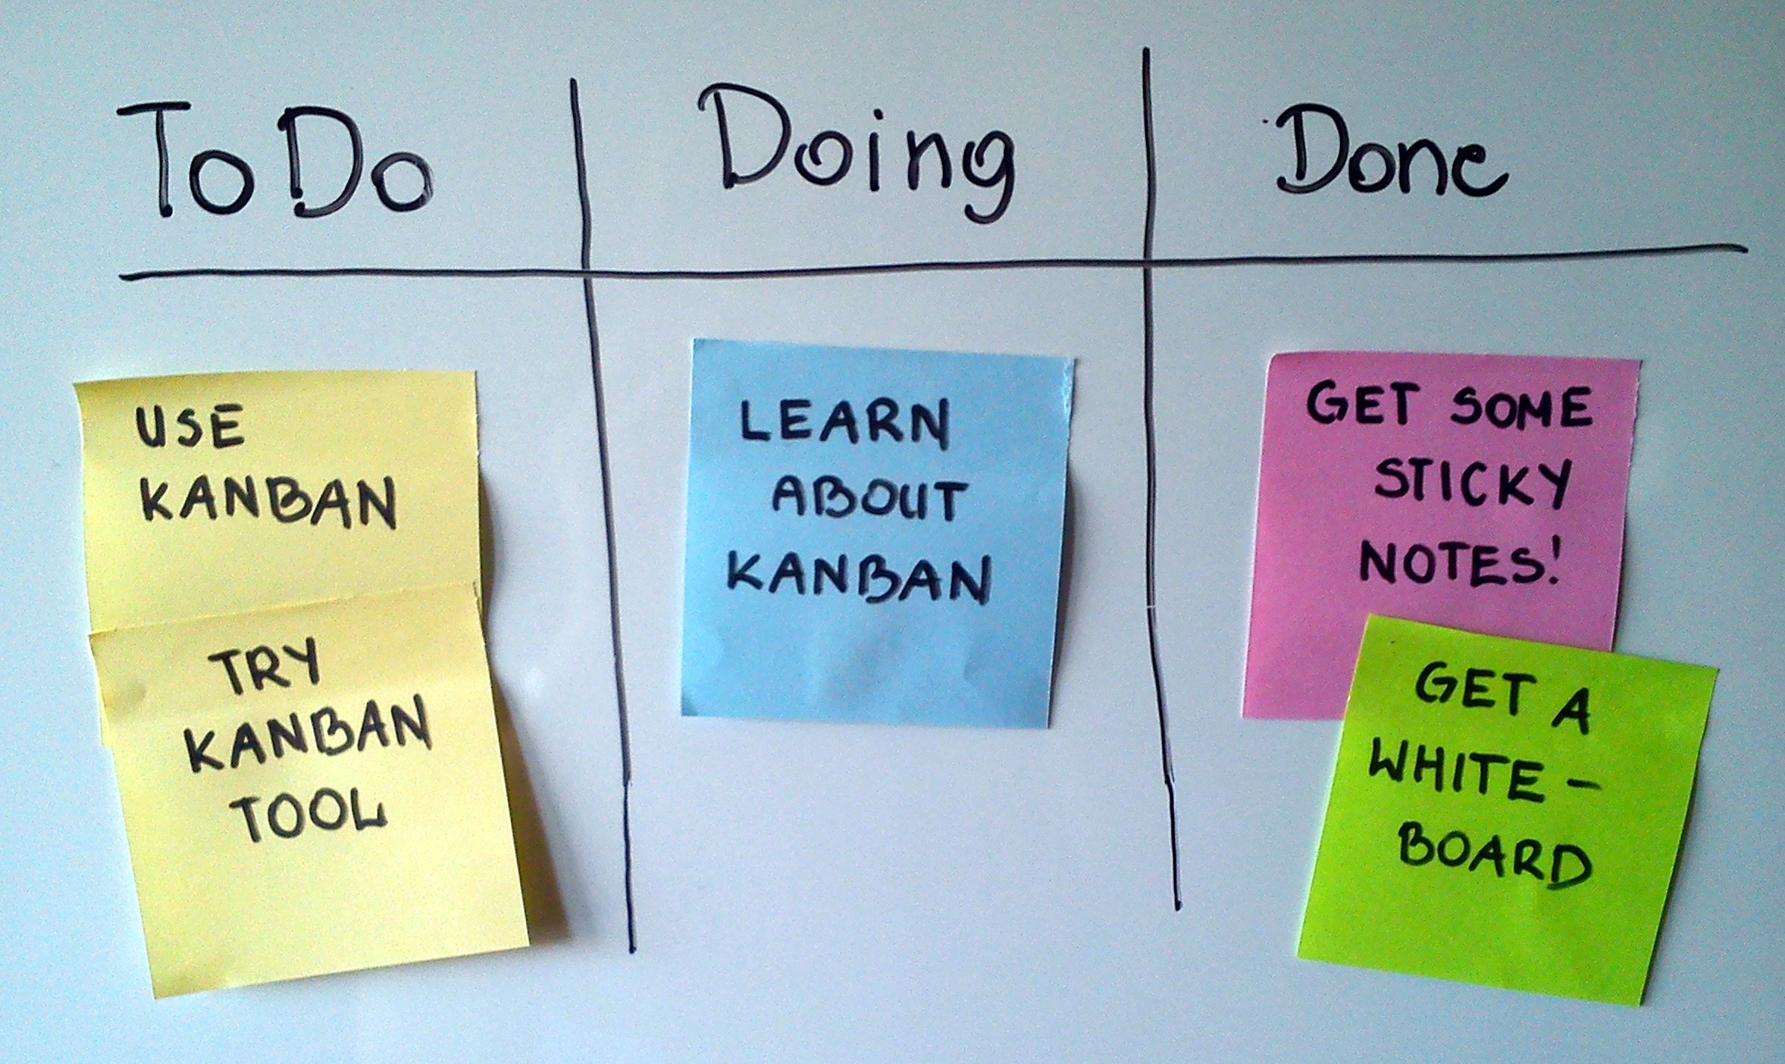
KANBAN BOARD
Kanban (看板) in Japanese, 看 (kan) can mean to look closely at, take care of, or keep watch. 板 (ban, or ita by itself) means a board. Therefore, Kanban roughly translated should be something like "a board to look at".

Slide 6
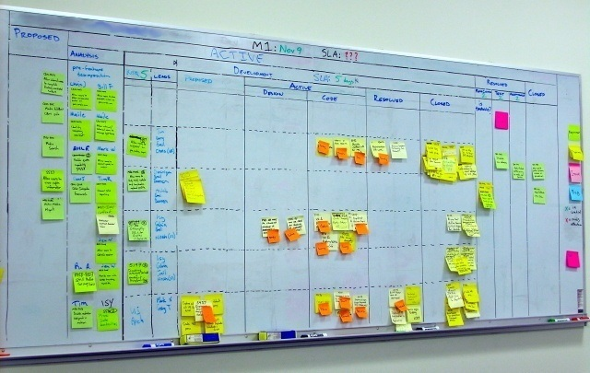

Slide 7
Project Management
_ The online Project Management services help the teams to create and organize the project, monitor the project process, assign members to the projects,…

Slide 8

Wrike
Website: www.wrike.com
History:
The company was founded in 2006 by entrepreneur Andrew Filev, and currently has offices in San Jose, San Diego, California, Dublin, Ireland, St Petersburg, Russia and Kiev, Ukraine
Mobile support:
iOS
Android
Logo

Slide 9
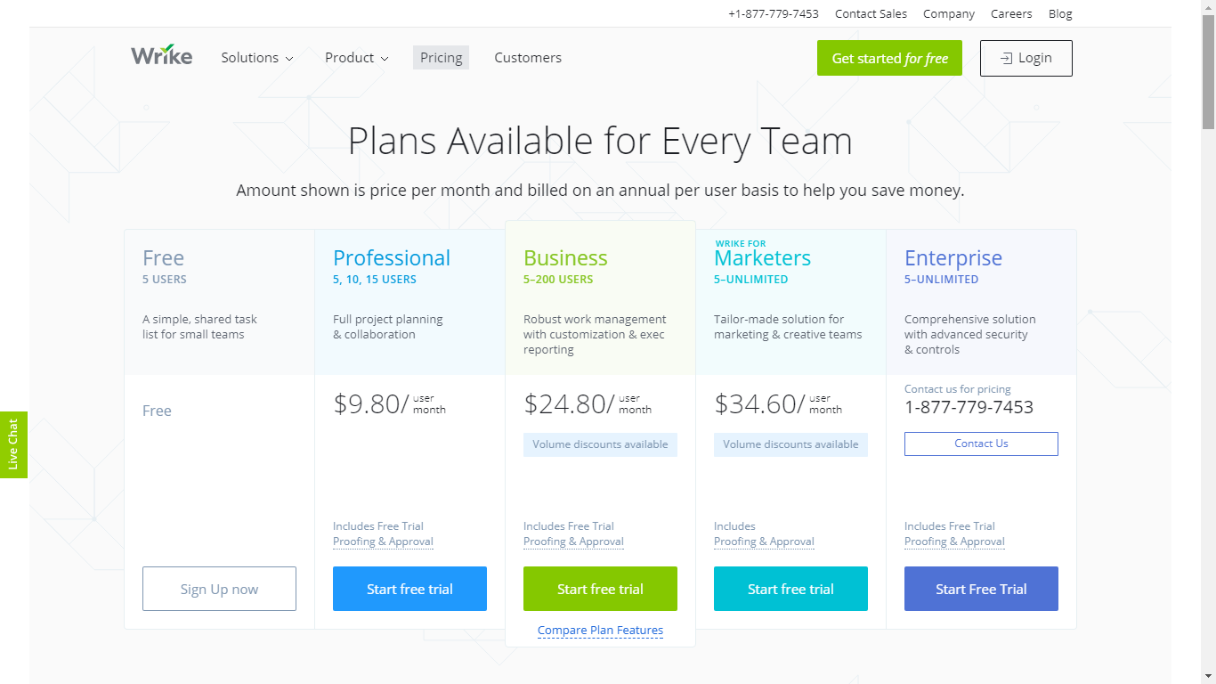
Wrike

Slide 10
Wrike
Some features:
Create Projects
Request Form & Automation
Live Editing & File Management
Timeline (Gantt-Chart)
Resource Management
Templates
Time & Budget Tracking
Personal Dashboard
Communication
Live activity stream
Create user groups
Email & Calendar Synchronization

Slide 11
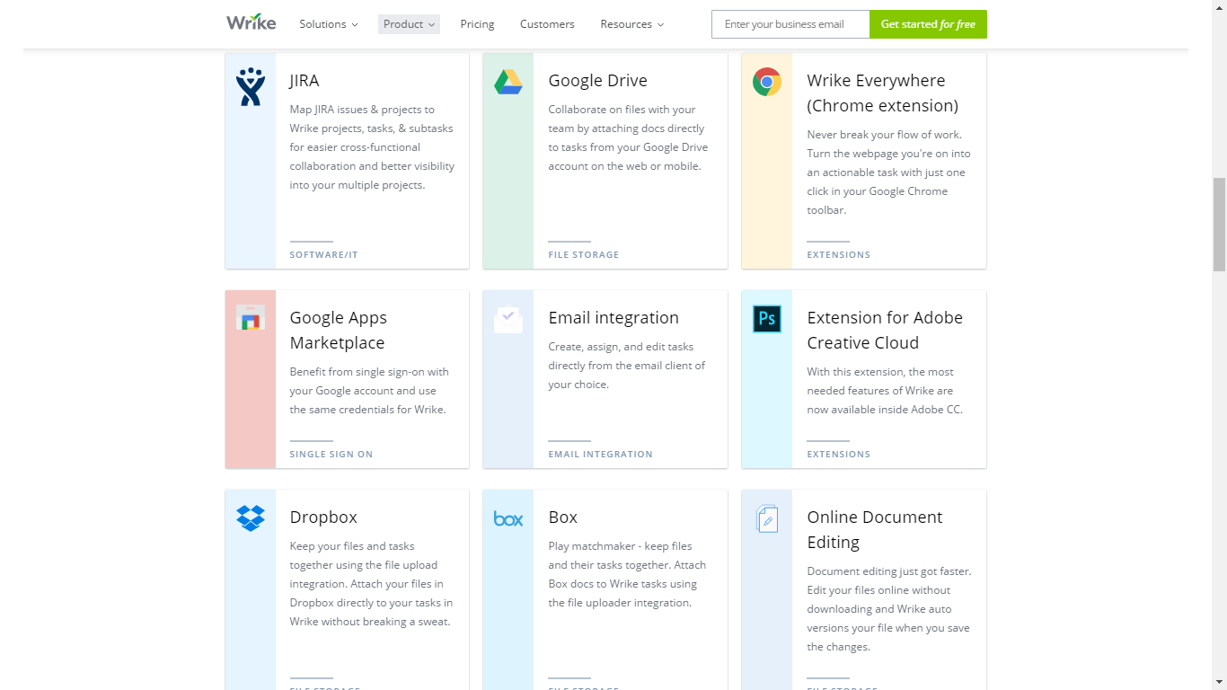

Slide 12
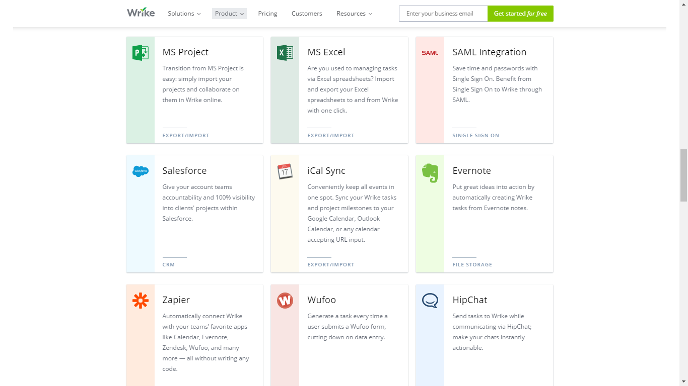

Slide 13
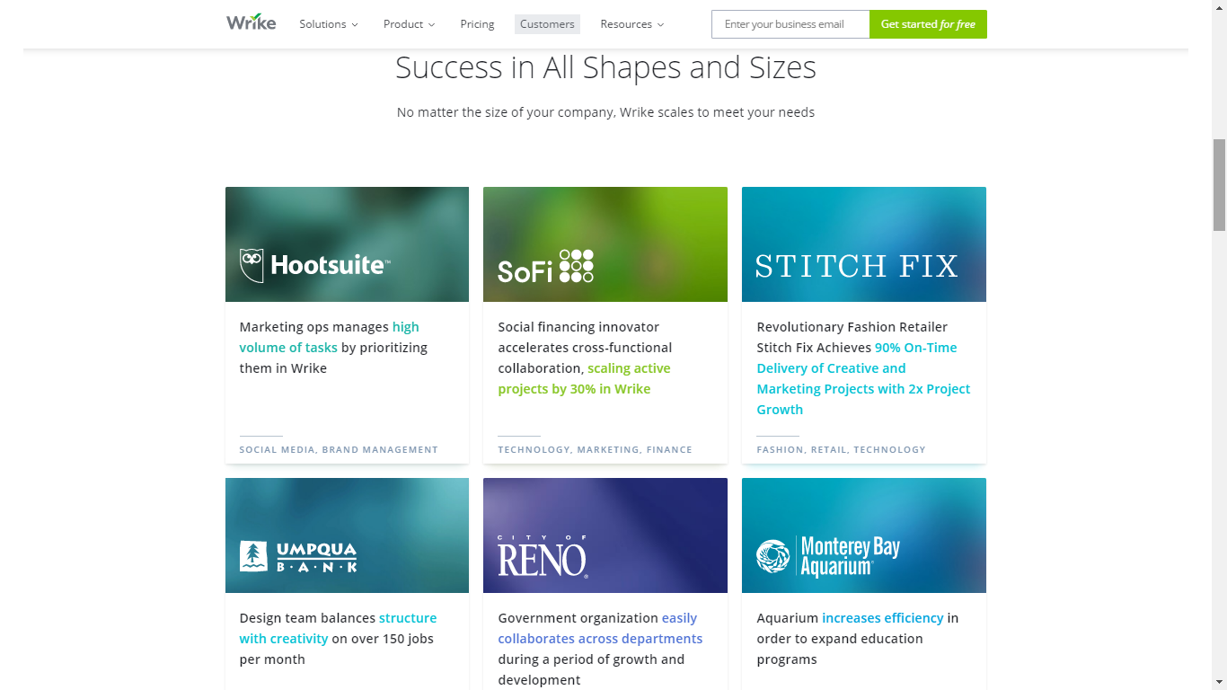

Slide 14
Wrike
Awards:
2009 - Red Herring's Top 100 Global Company Award
2015 - Listed in by Deloitte’s 2015 Technology Fast 500TM Ranking
2015 - Named one of the "Best Places to Work" by San Francisco Business Times/Silicon Valley Business Journal
Group B comment:
Very good general purpose online Project Management tool, Kanban board supported, task management. Many features but only for paid account.

Slide 15

TAIGA
Website: https://taiga.io/
History: Taiga formally came with the creation of Taiga Agile, LLC in February 2014 that provided the formal structure for the Taiga project
Mobile support:
Android and iOS
Logo

Slide 16
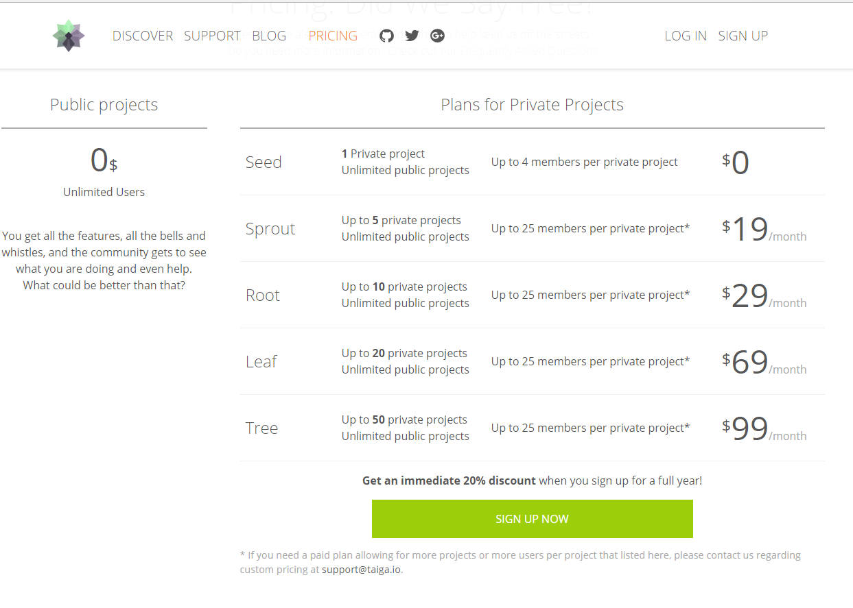
TAIGA

Slide 17
TAIGA
Some features:
Tool for project management
Support Scrum methodlogy
KANBAN dashboard
Epic multi project
Personal Dashboard
Multiplatform importers

Slide 18
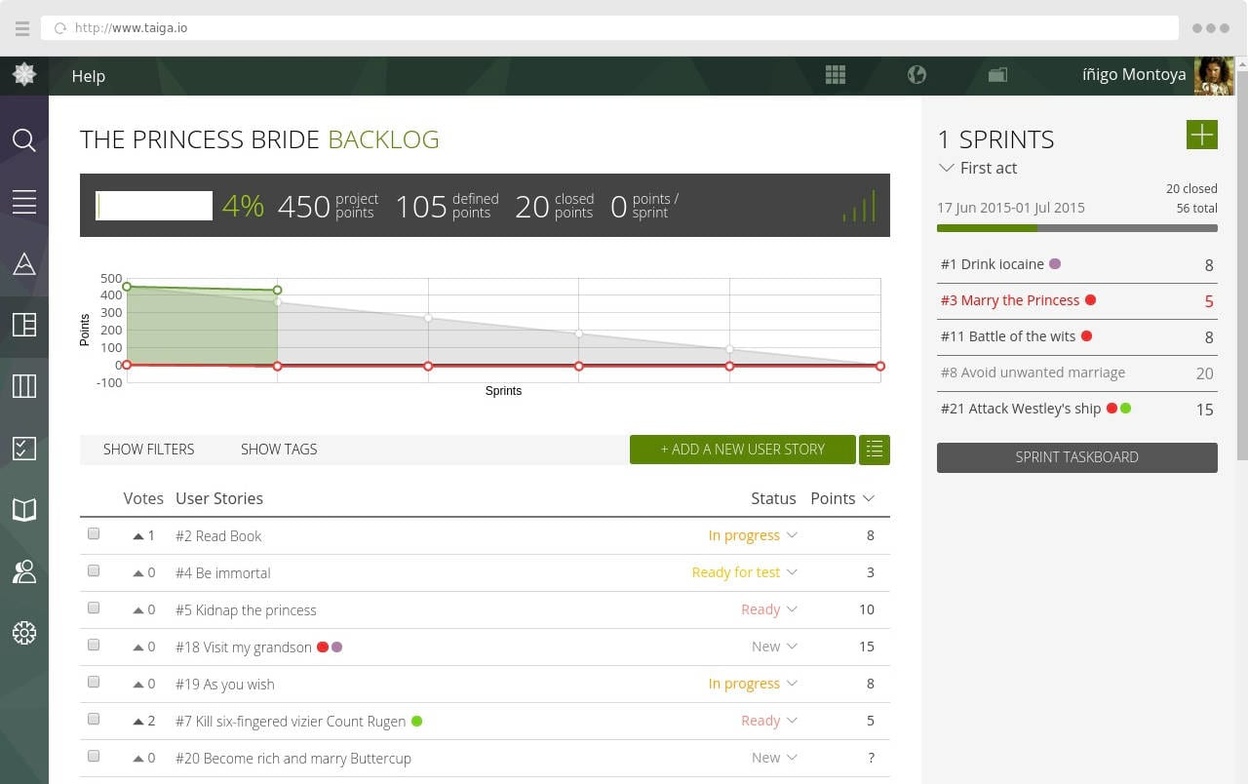

Slide 19
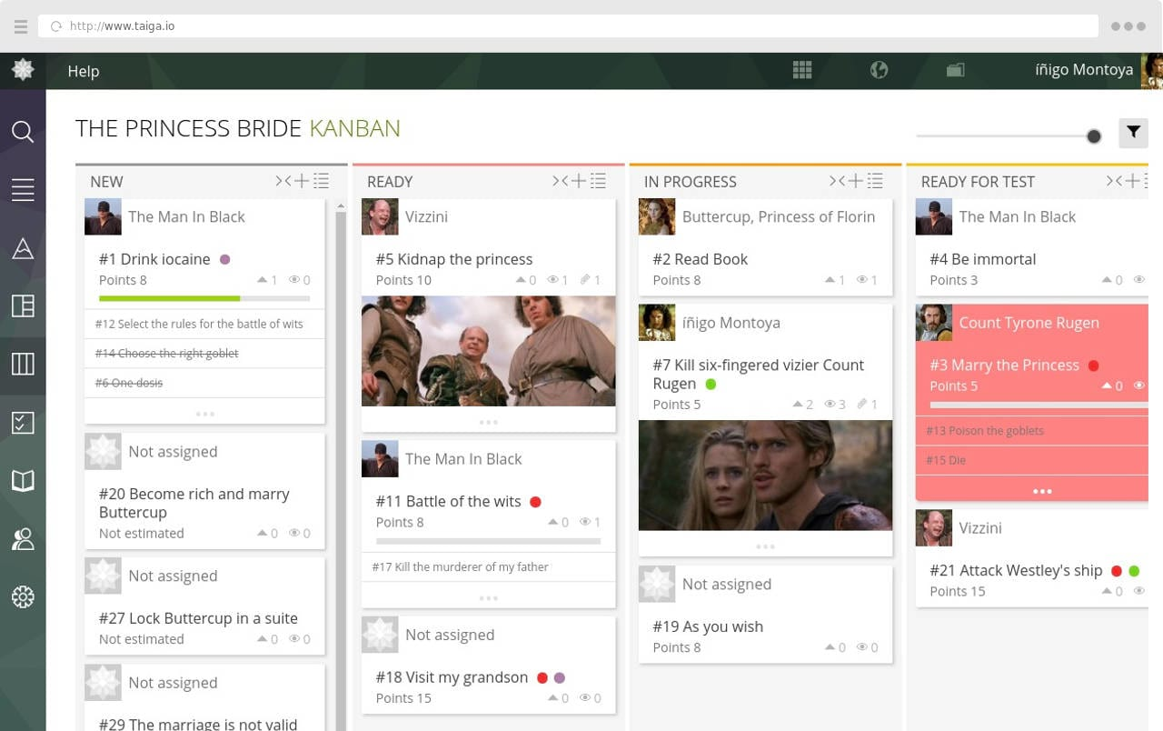

Slide 20
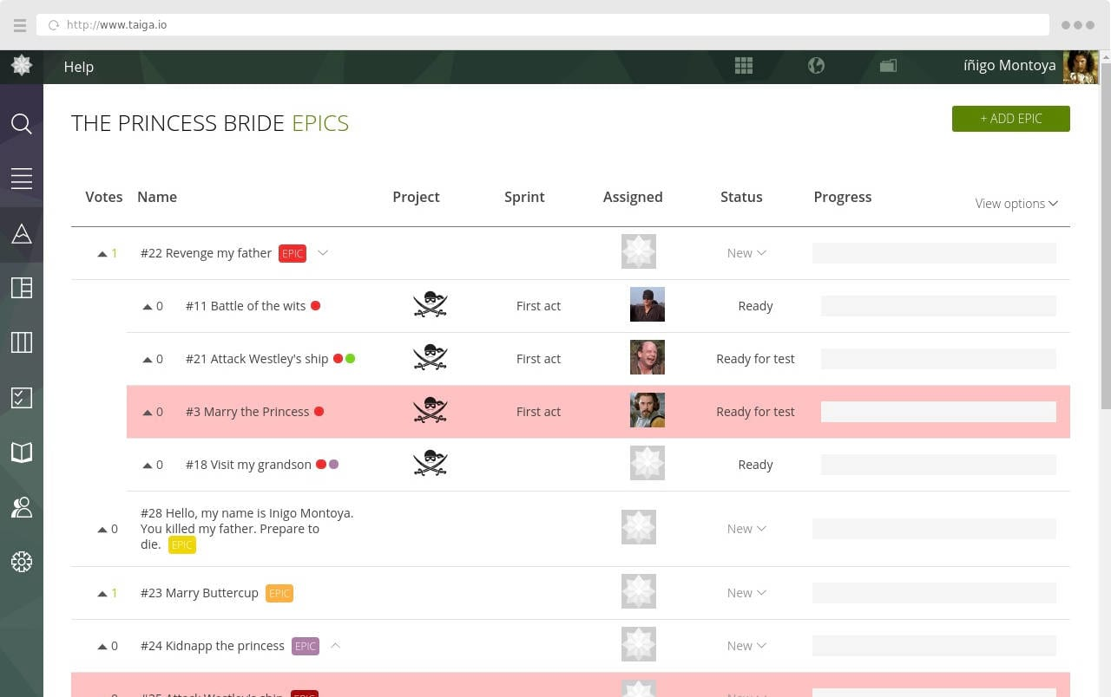

Slide 21
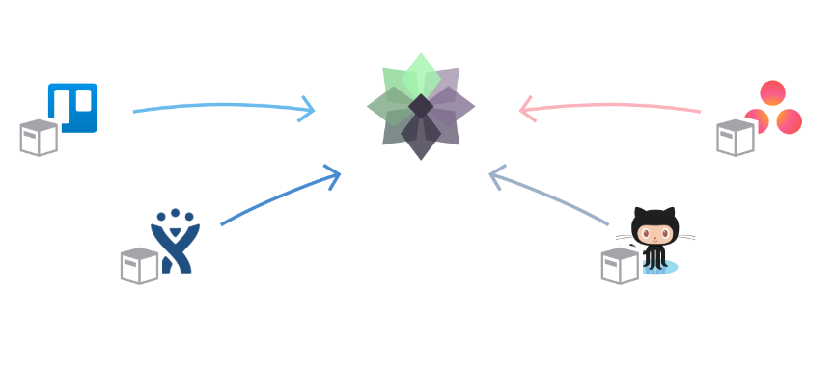

Slide 22
Taiga
Awards
Taiga won the 2015 Most Valued Agile Tool awarded by the Agile Portal.
It's been cited as one of "Top 10 open source projects in 2014" and "Top 11 project management tools for 2016" by Opensource.
Group B comment:
Taiga is one of the most popular Agile - SCRUM project management, task management service.

Slide 23

Asana
Website: https://asana.com/
History:
Founded in 2008 by Facebook co-founder Dustin Moskovitz and ex-engineer Justin Rosenstein, who both worked on improving the productivity of employees at Facebook. (Asana was named after a Sanskrit word meaning “yoga pose”)
Mobile support:
iOS
Android
Logo

Slide 24
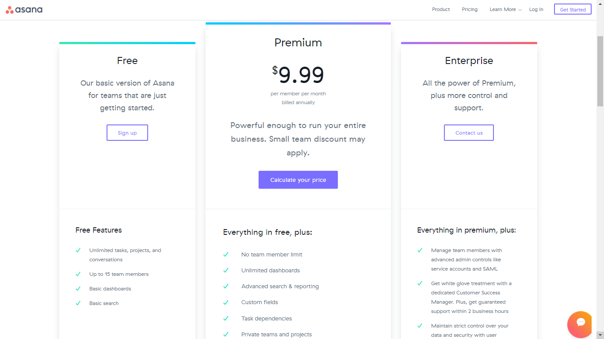
Prices / Versions

Slide 25
Asana
Some features:
Project Management
Task Management
Agile Management
Work Tracking
Team solutions:
Engineering
Designers
Sales
HR
Marketing

Slide 26
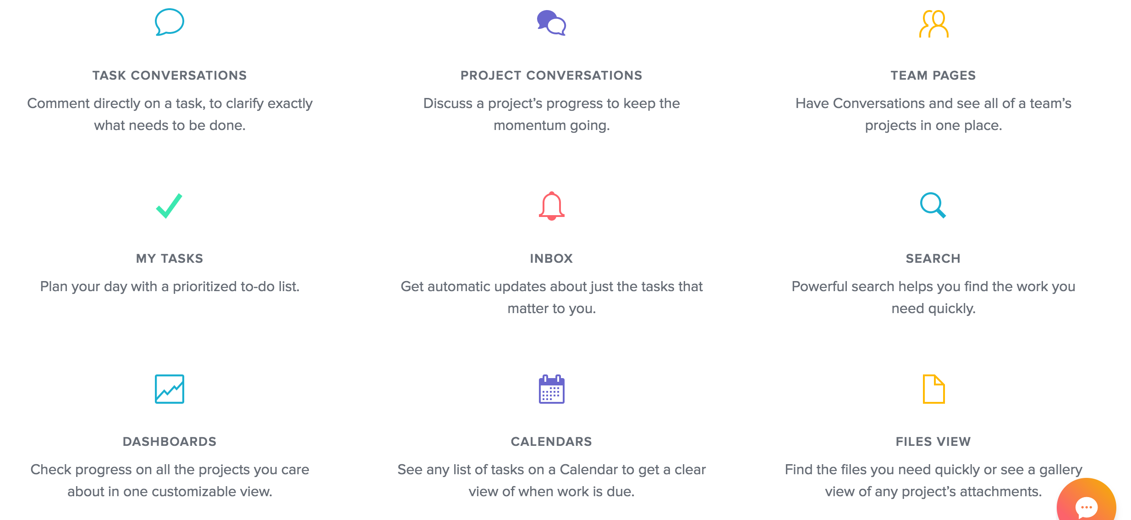
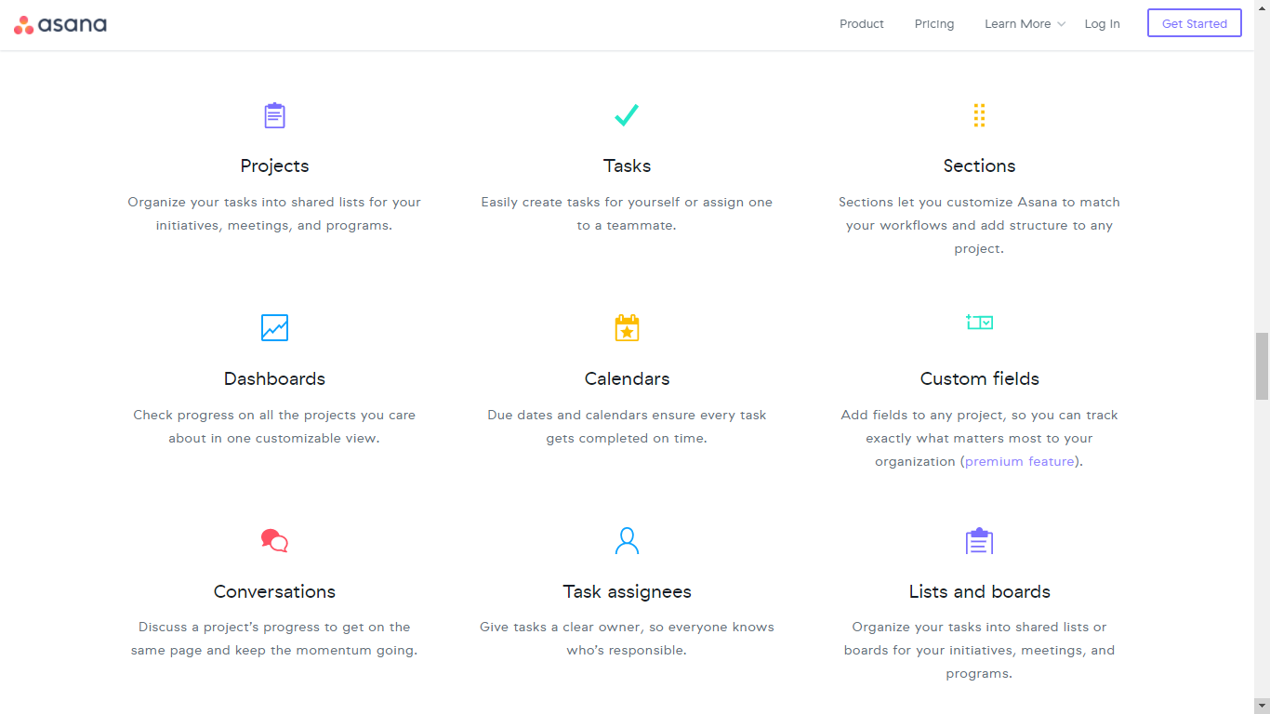

Slide 27
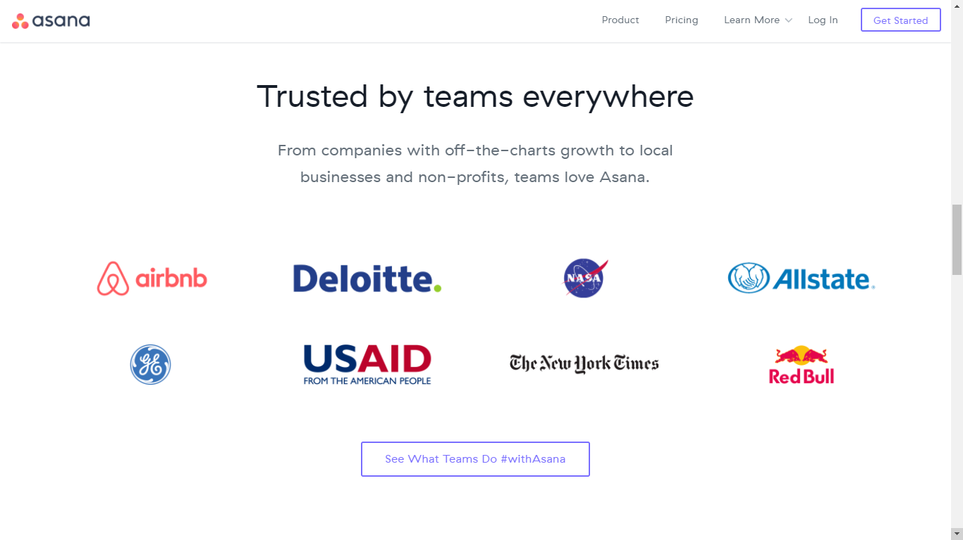

Slide 28
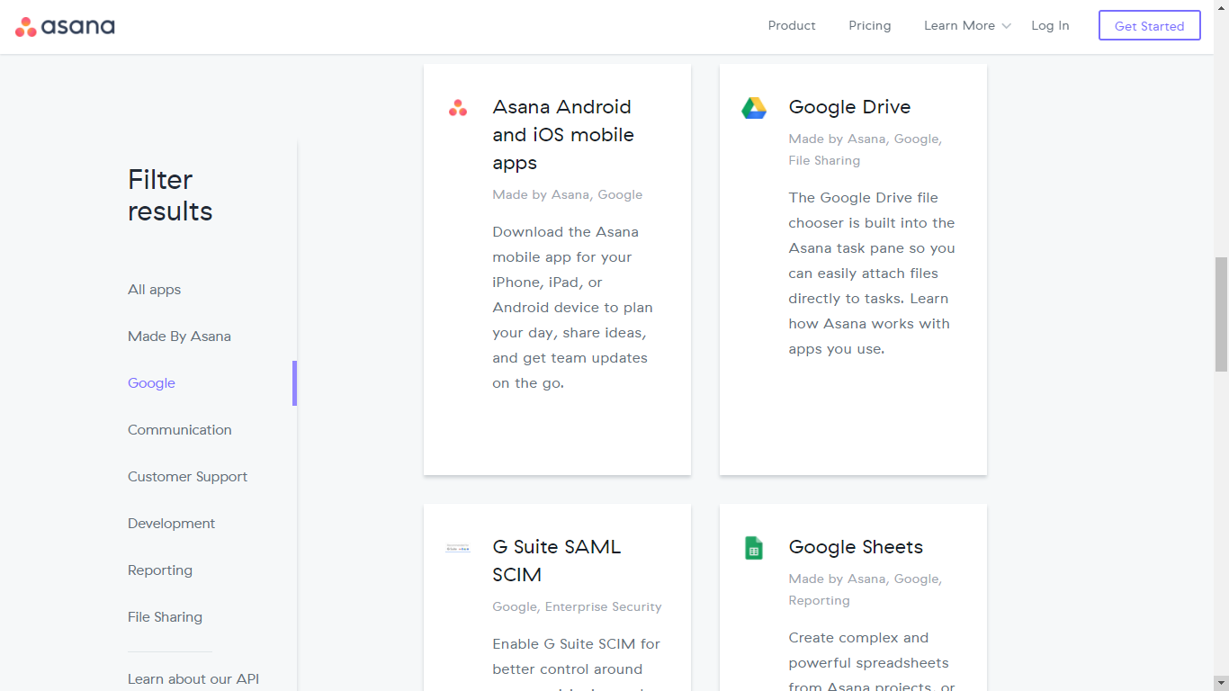
Integration

Slide 29
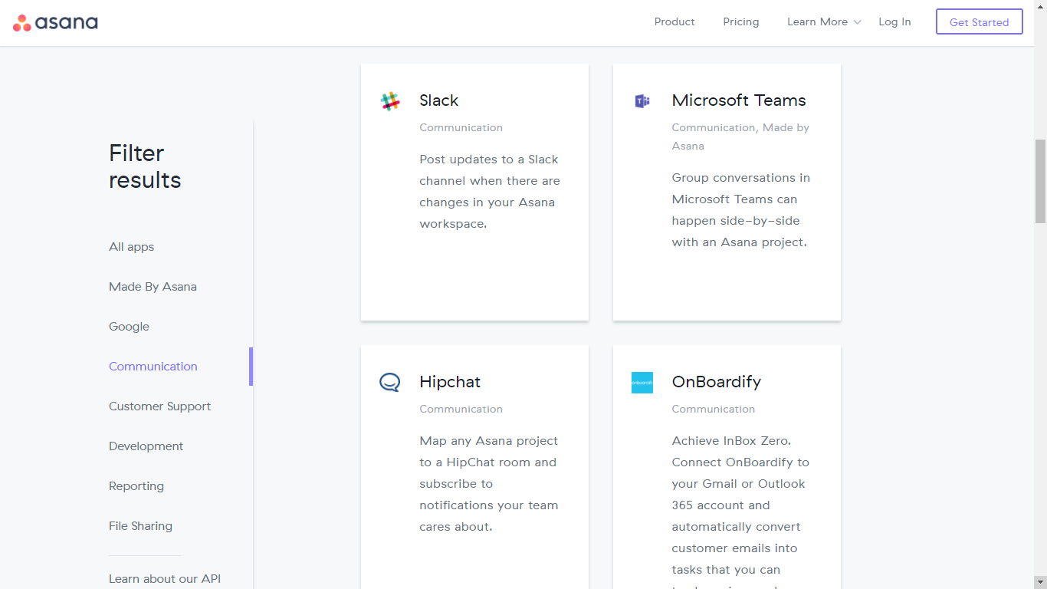

Slide 30
Asana
Awards:
On July 23, 2012, Asana announced a new round of funding — Peter Thiel and Founders Fund, along with existing investors Benchmark, Andreessen-Horowitz, and Mitch Kapor, have invested $28 million in Asana
According to a New York Times article and someone briefed on the funding, the investors valued the company at $280 million.
Group B comment:
Asana is a very good general purpose project management service, also support Agile and many other type of teams.

Slide 31

Podio
Website: https://glip.com/
History:
The Service that was founded in 2009 and acquired by Citrix in 2012
Mobile support:
iOS
Android
Logo

Slide 32
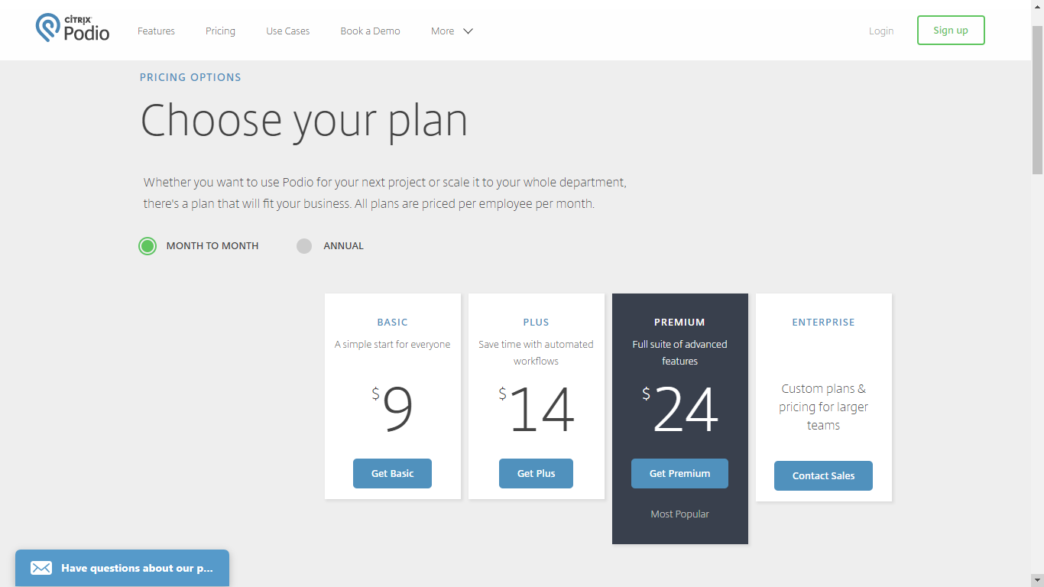
Podio

Slide 33
Podio
Some features:
Web and Mobile Device
Social Collaboration
Intergrated Chat
Task Management
Project Management
Schedule Meetings
Granular Access
Grim Connected
Automatic Worklows
Unlimitted Hosting

Slide 34
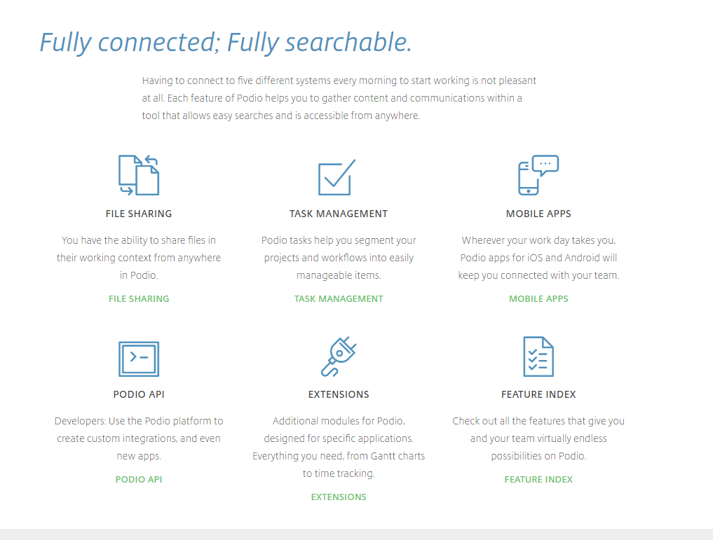

Slide 35
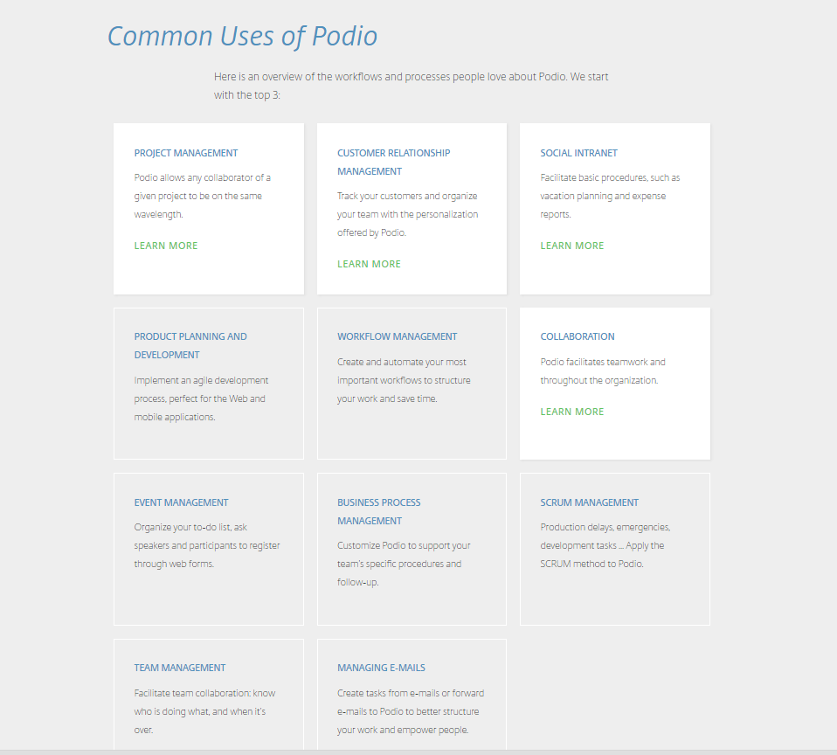

Slide 36
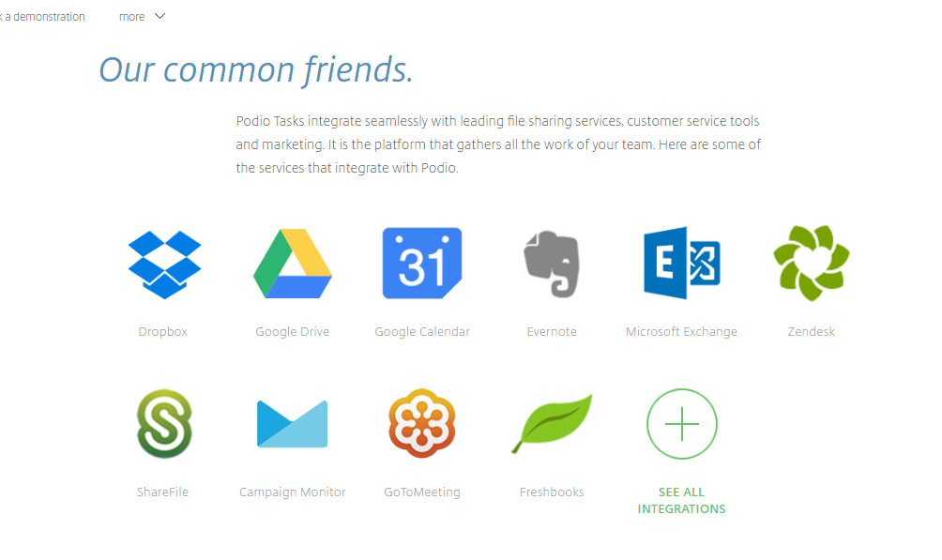

Slide 37
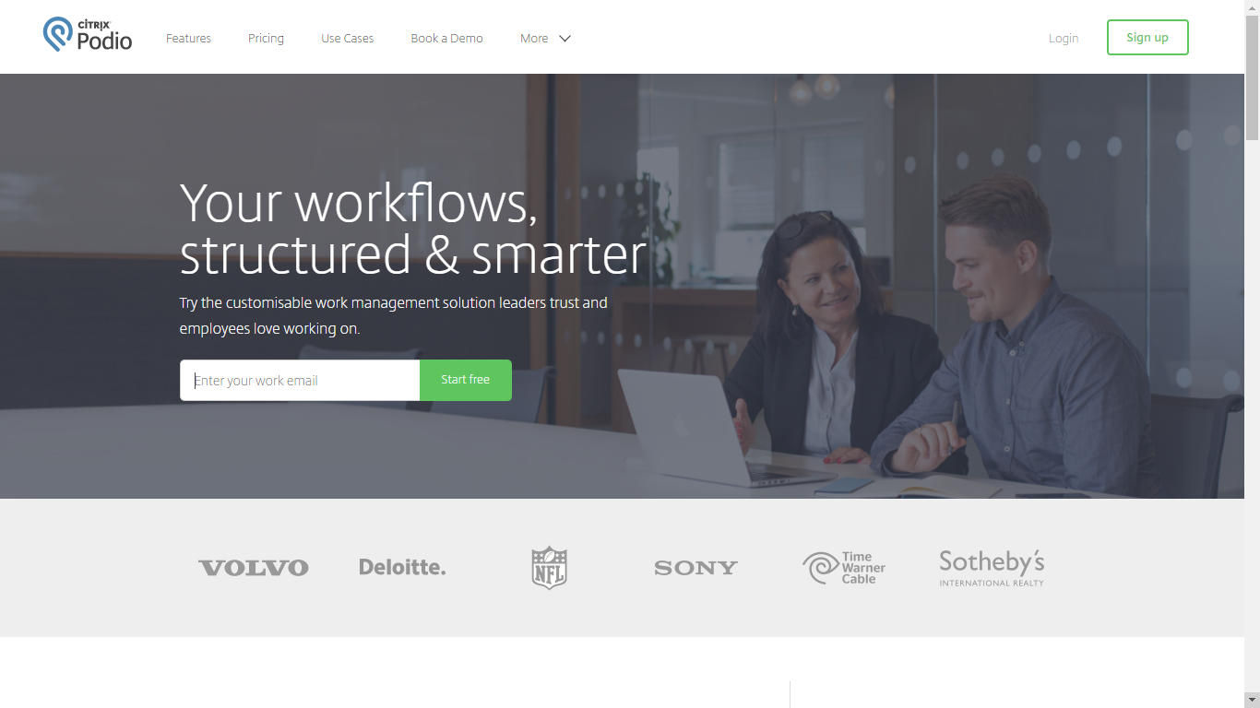

Slide 38
Podio
Awards:
Editor's choice for “The Best Online Collaboration Sofware of 2016”
The Podio App Market has hundreds of vertical solutions from 14 industries and 23 functional groups for you to choose from
Group B comment:
Podio is a general project management service, with rich features and many management type: SCRUM management, workflow management, event management.

Slide 39
 | Wrike | Taiga | Asana | Podio
Price | Free + Pay | Free + Pay | Free + Pay | Free + Pay
Mobile app | Android, iOS | Android, iOS | Android, iOS | Android, iOS
Traits – Some Features | General Purpose Gantt chart Kanban board Integration | Strong Agile/Scrum Support Gantt chart Kanban board Integration | General Purpose Support many type of teams Gantt chart Kanban board Integration | General Purpose Gantt chart Kanban board Integration

Slide 40
Task Management
_ The online Task Management services help the team to create and organize the tasks, assign the member to each tasks, set the duration of the task,…

Slide 41

Trello
Website: https://trello.com/
History:
Made by Fog Creek Software in 2011
Acquired by Atlassian in 01/2017
Mobile Support:
Android, iOS
Logo

Slide 42
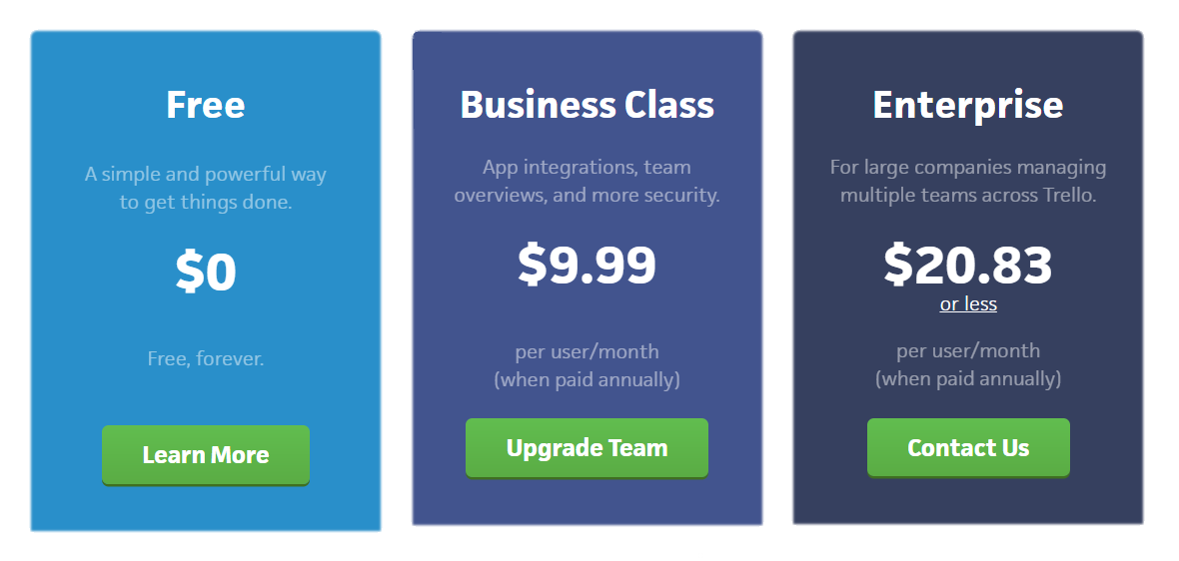
Trello

Slide 43
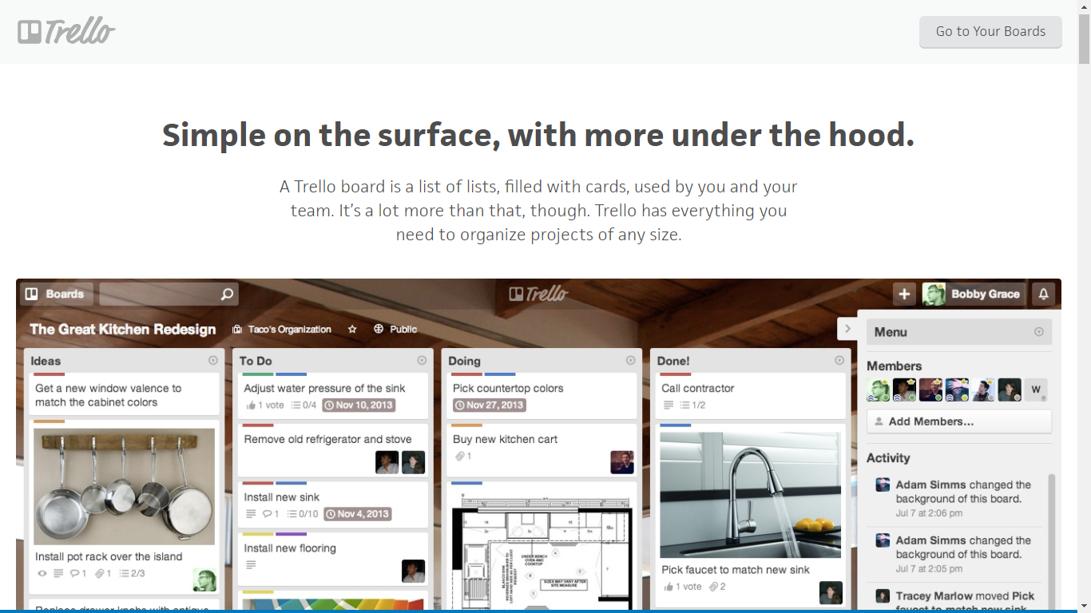
Trello

Slide 44
Trello
Some features:
Task management
Task planning
Task scheduling
Task tracking
Project tracking
Time tracking by project
Third party integration
Collaboration tools
Attach photos, drawings, sketches & mockups

Slide 45
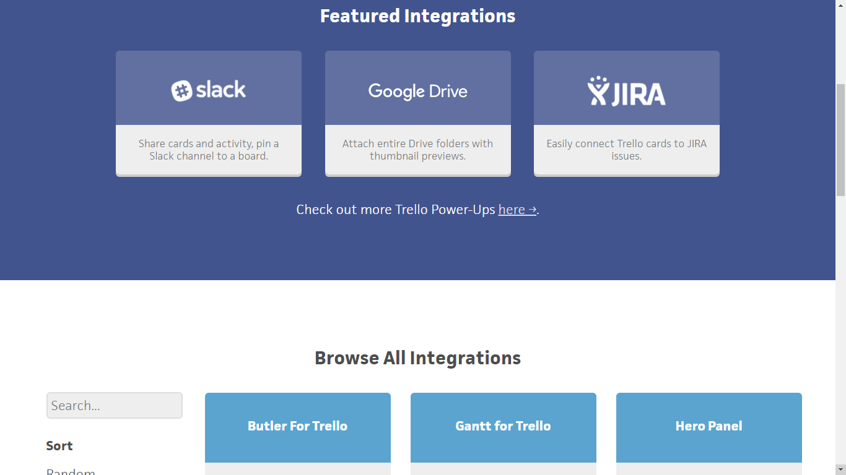
Trello

Slide 46
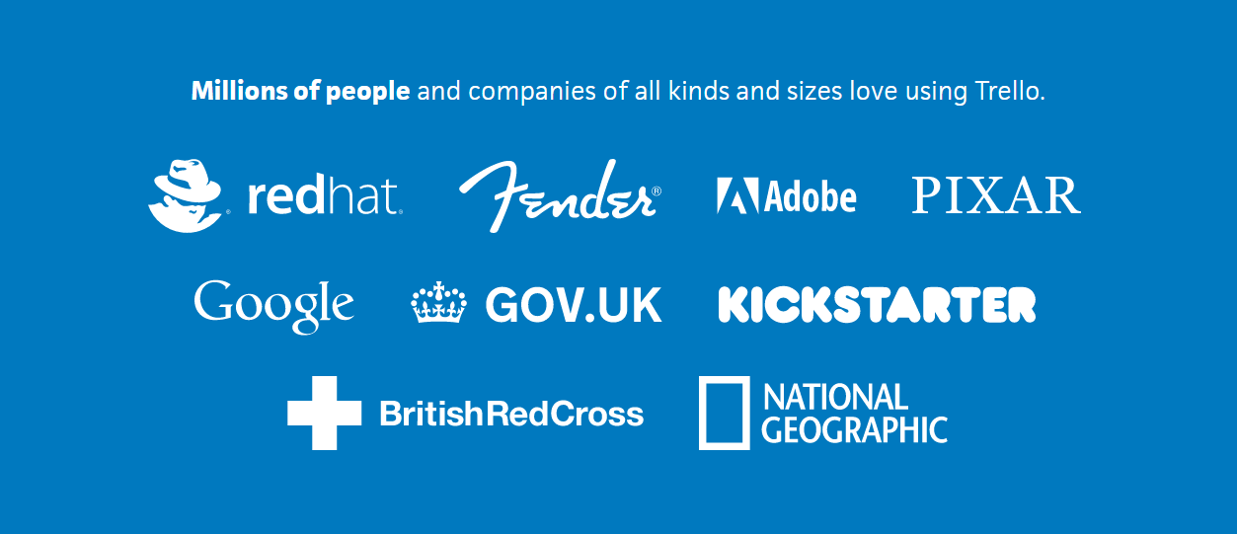
Trello

Slide 47
Trello
Awards
In July 2012, the site surpassed 500,000 users.
In December 2012 more than 1,000,000.
As of October 14, 2015, it had 10 million users.
On January 9, 2017, Atlassian announced its intent to acquire Trello for $425 million. The transaction was made with $360M in cash, while the remaining $65M was made with shares and options
Group B comment:
Trello is one of the best (probably the best) Kanban board supported-tool. Simple, easy to use, extraordinary performance, excellence UI/UX.

Slide 48

Quire
Website:
www.quire.io
History:
Founded by Potix
Mobile support:
iOS
Logo

Slide 49
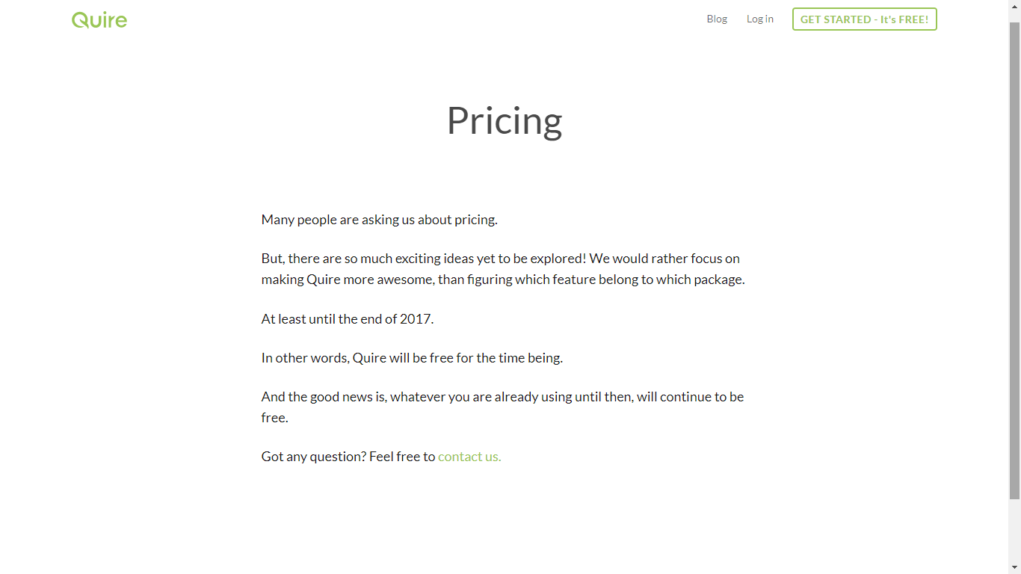

Quire

Slide 50
Quire
Some features:
Collaboration
File Sharing
Idea Management
Issue Management
Project Planning
Task Management
Resource Management
Percent-Complete Tracking

Slide 51
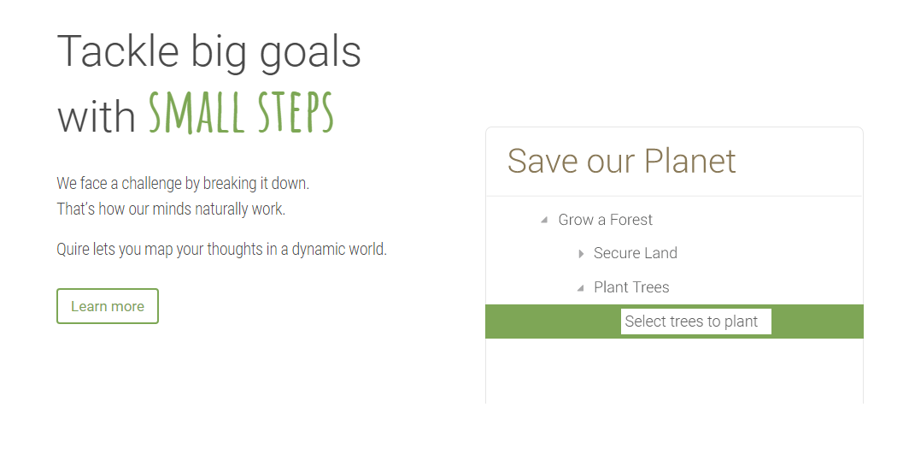

Slide 52
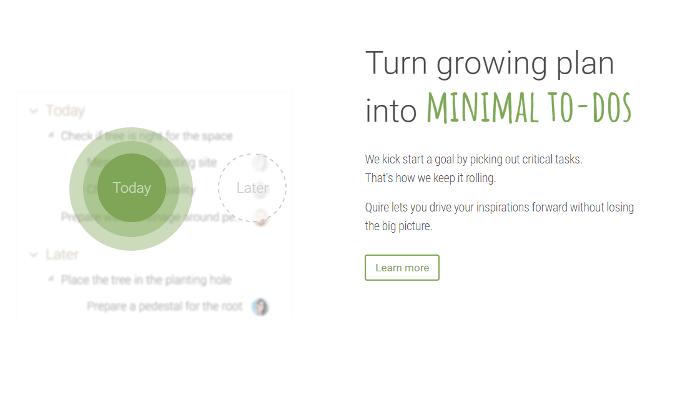

Slide 53
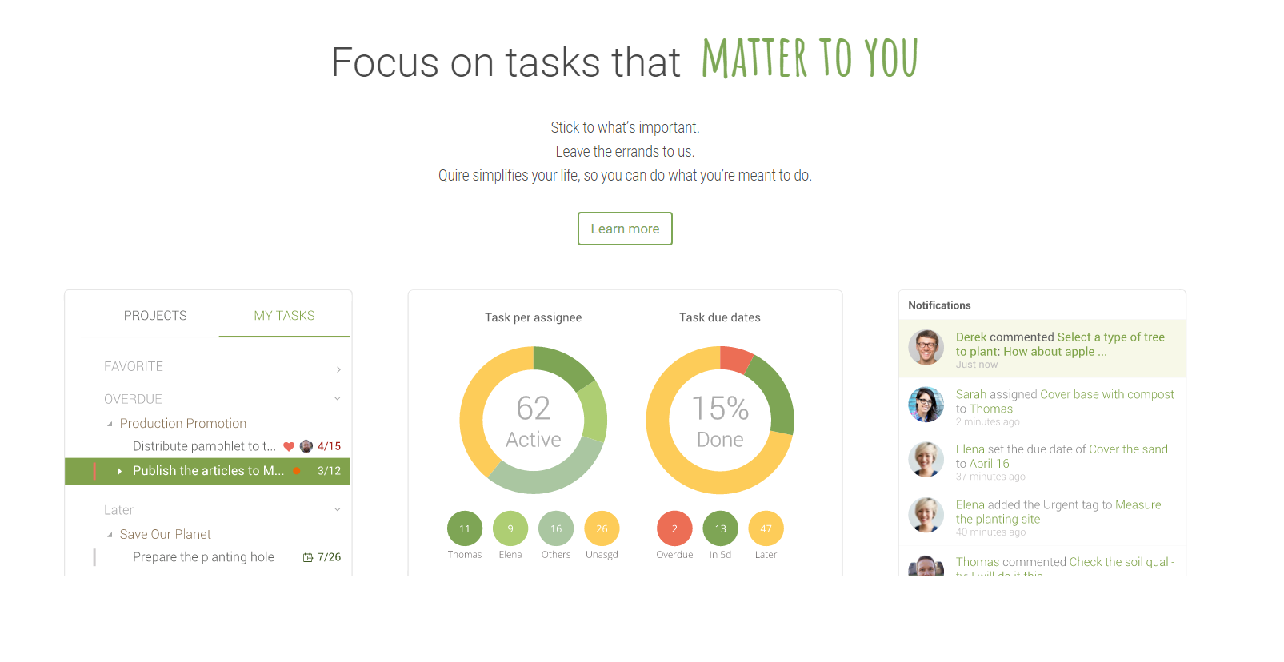

Slide 54


Slide 55
Quire
Awards:
Group B comment:
Quire is a new, yet promising task management service.

Slide 56

Meistertask
Website: https://www.meistertask.com/
History: Establish in 2015
Mobile support:
Android and iOS
Logo

Slide 57
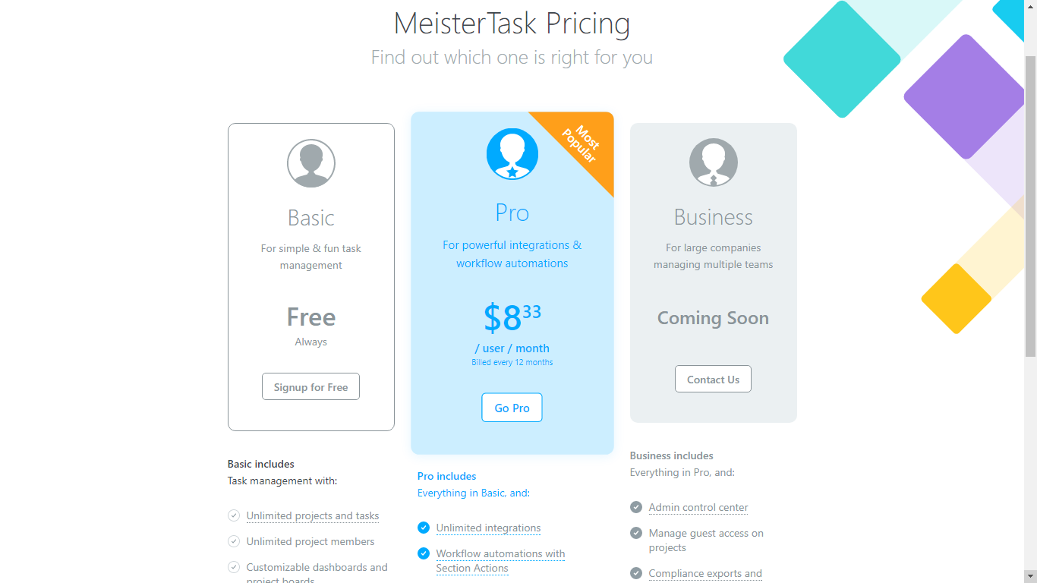
Meistertask

Slide 58
Meistertask
Some features:
Task management
Operating based on Smart, Agile & Visual
Support mind map
Support Multiple Communication
Personal Dashboard
Unlimited invitation members for project
Tracking member’s progress

Slide 59
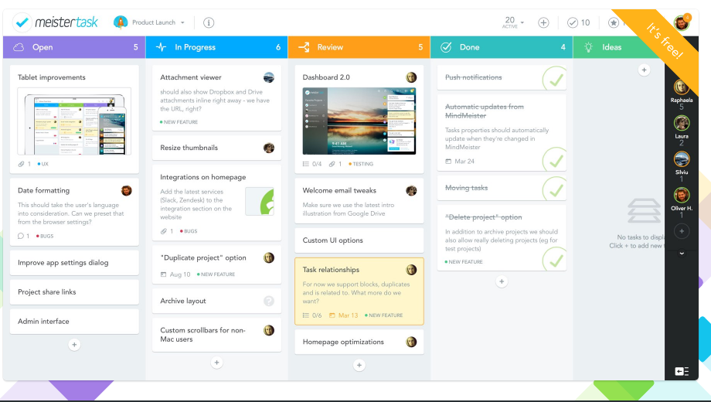

Slide 60
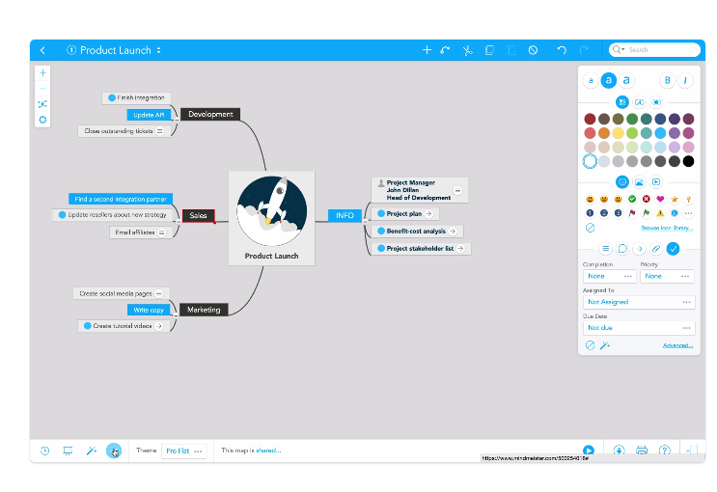
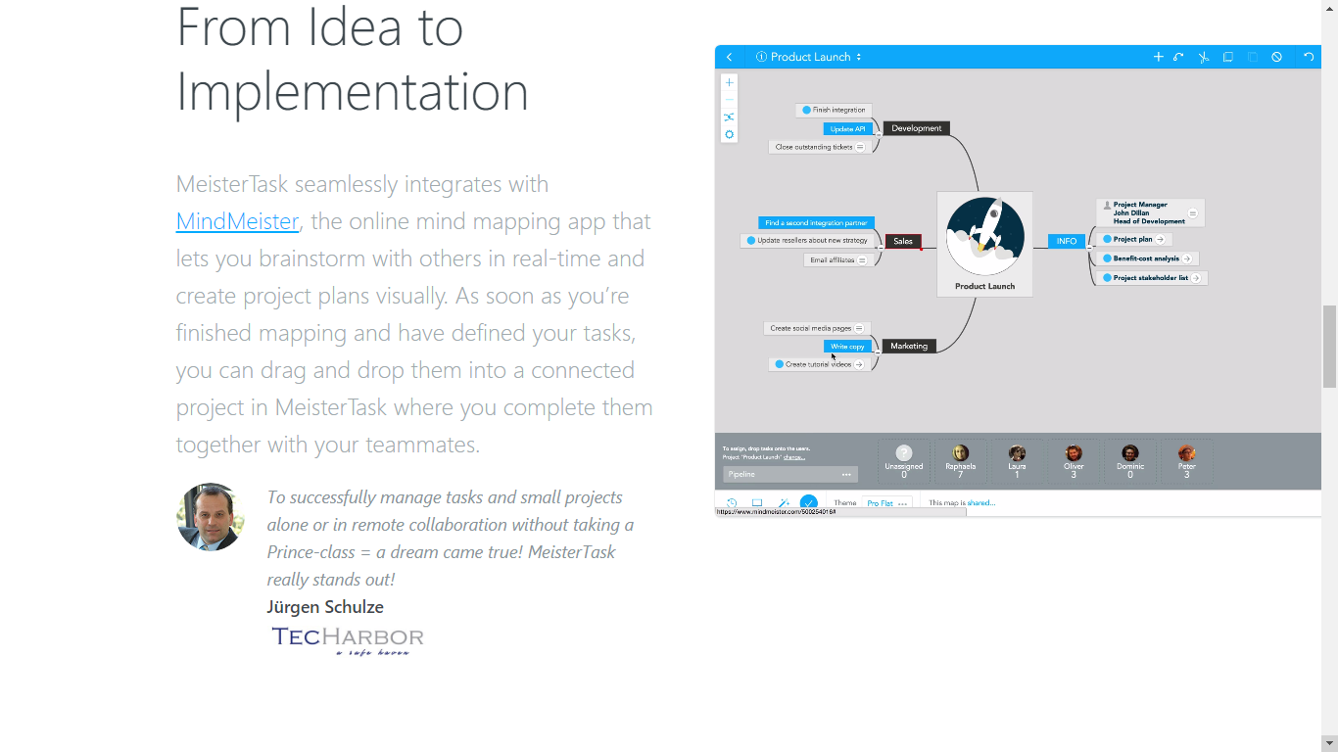

Slide 61
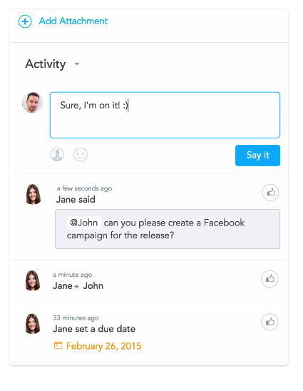

Slide 62

Meistertask

Slide 63
Meistertask
Awards:
Best app 2015 – App store
Best app 2015 – Google play
Group B comment:
Meistertask is growing rapidly. Support for Kanban board, real-time chat and Mind Manager.

Slide 64
 | Trello | Quire | Meistertask
Price | Free + Pay | Free + Pay | Free + Pay
Mobile app | Android, iOS | iOS | Android, iOS
Traits – Some Features | Kanban board Integration Simple & excellent performance, popular | Kanban board Integration New & Promising | Kanban board Integration Mind Manager Collaboration (MindMeister) integrated

Slide 65
Team Communication
_ The online Project Management services help the team to stay in touch, communicate with each others,…

Slide 66

Slack
Website: www.slack.com
History:
Slack is a cloud-based set of team collaboration tools and services, founded by Stewart Butterfield. The name is an acronym for "Searchable Log of All Conversation and Knowledge".
Mobile support:
iOS
Android
Logo

Slide 67
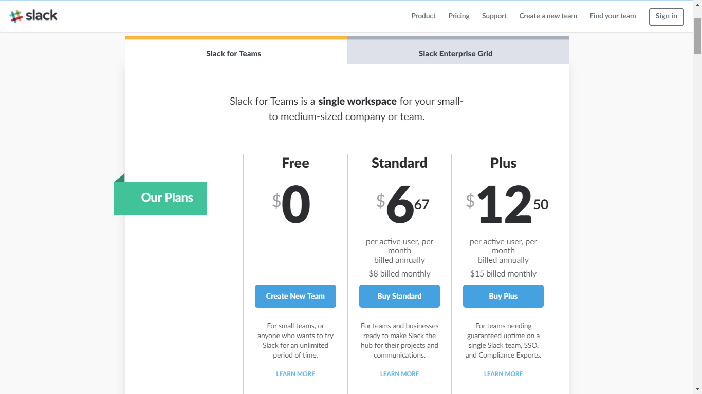
Slack
Website: www.slack.com
History:
Slack is a cloud-based set of team collaboration tools and services, founded by Stewart Butterfield. The name is an acronym for "Searchable Log of All Conversation and Knowledge".
Mobile support:
iOS
Android
Logo

Slide 68
Slack
Some features:
Team chat
Video and voice chat
Upload file
Code-snippet
Direct message
Assistant bot
App directory (integration)
Searching for text, files,…

Slide 69
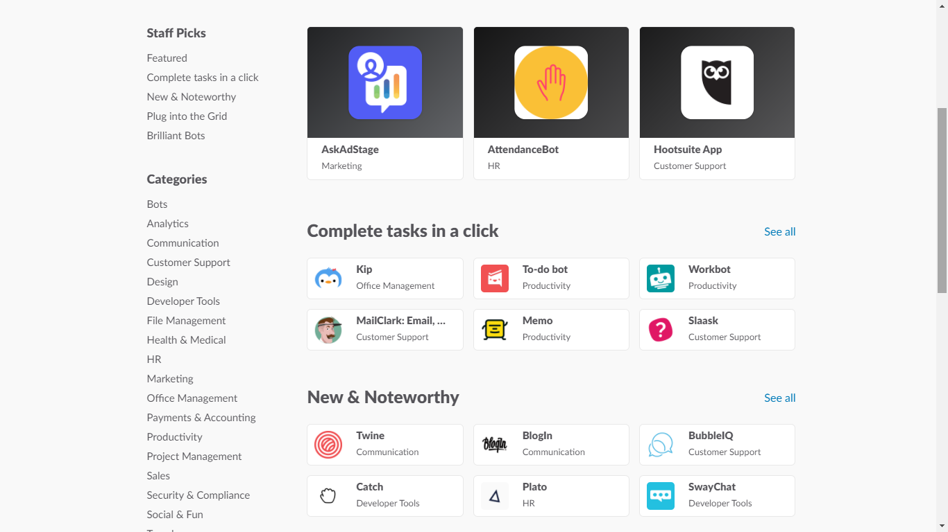
Slack

Slide 70
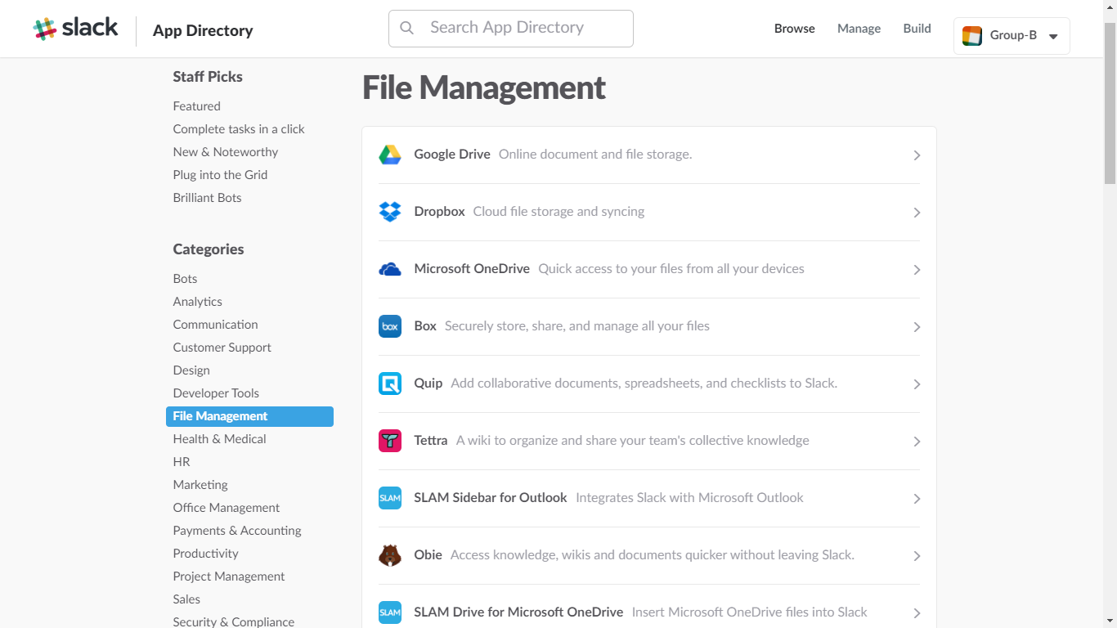
Slack

Slide 71
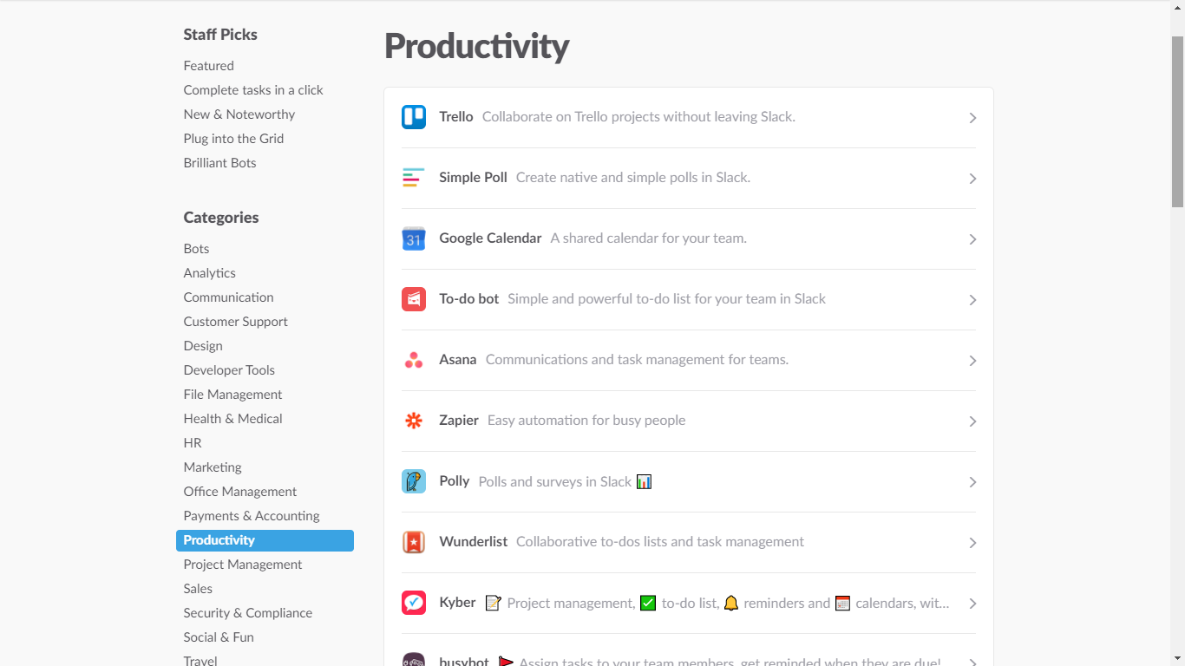
Slack

Slide 72
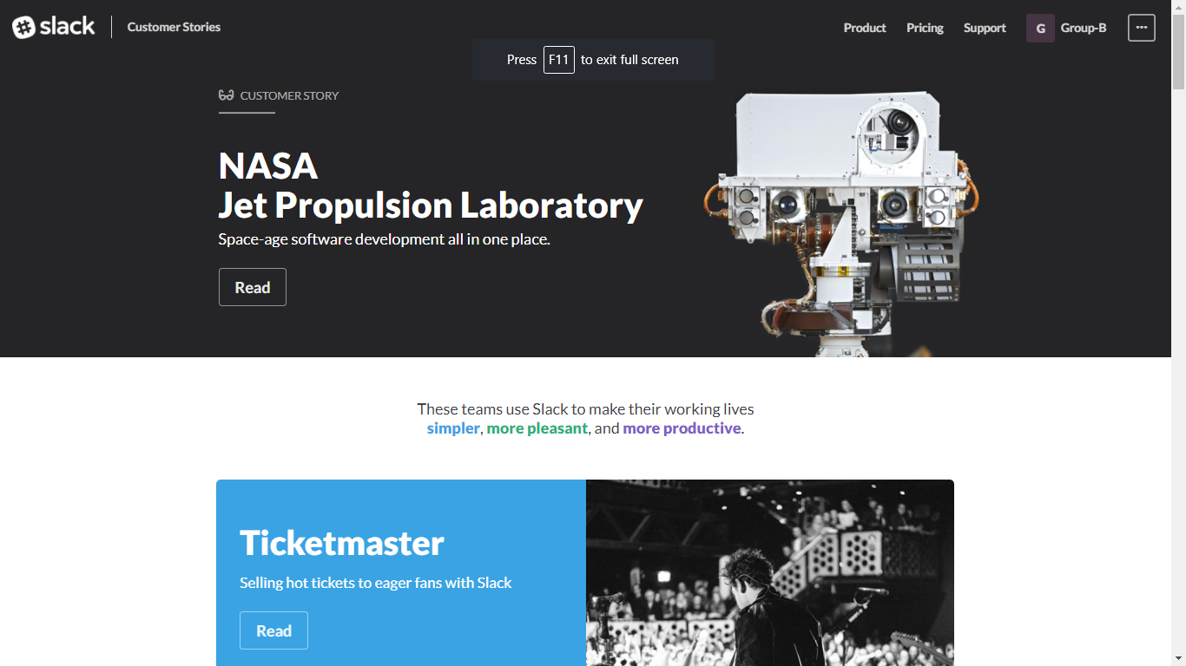
Slack

Slide 73
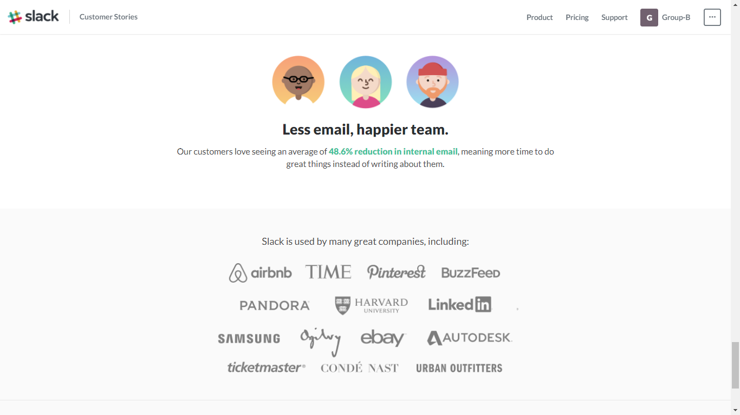
Slack

Slide 74
Slack
Awards:
The Financial Times wrote in March 2015 that Slack was the first business technology to have crossed from business into personal use since Microsoft Office and the BlackBerry.
Slack was recognized as the best startup of the year at the 10th Crunchies Awards, organized by TechCrunch.
Group B comment:
Very good general purpose online Project Management tool, Kanban board supported, task management. Many features but only for paid account.

Slide 75

Skype
Website: https://www.skype.com/
History:
Made by Niklas Zennström and Janus Friis in 29/03/2003
Acquired by Microsoft in 10/05/2011
Price:
Free to use
Skype credit
Logo

Slide 76

Supported Devices
Windows
Ios
Linux
Android
iPhone
Windows phone
BlackBerry
Amazon Fire Phone
iPod touch
iPad
Andoird
Kindle Fire HD
Windows
Xbox One
Apple Watch
Android Wear

Slide 77
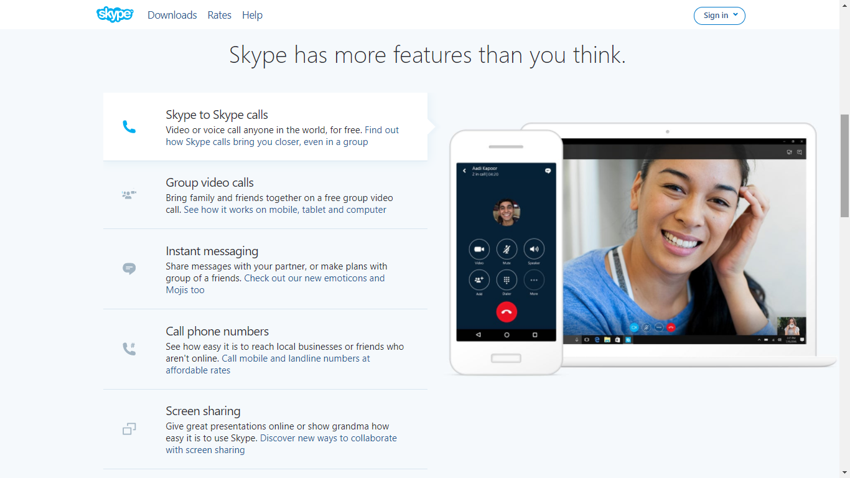
Skype

Slide 78
Skype
Some features:
SkypeIn (allows to receive calls to a local Skype phone number)
SkypeOut (used to call to non-Skype users with a low price ≥$0.025)
Message
Group call
Video Call
Share screens, photos, videos, documents, and files (up to 300MB)
Use directly at www.skype.com, doesn’t require account

Slide 79
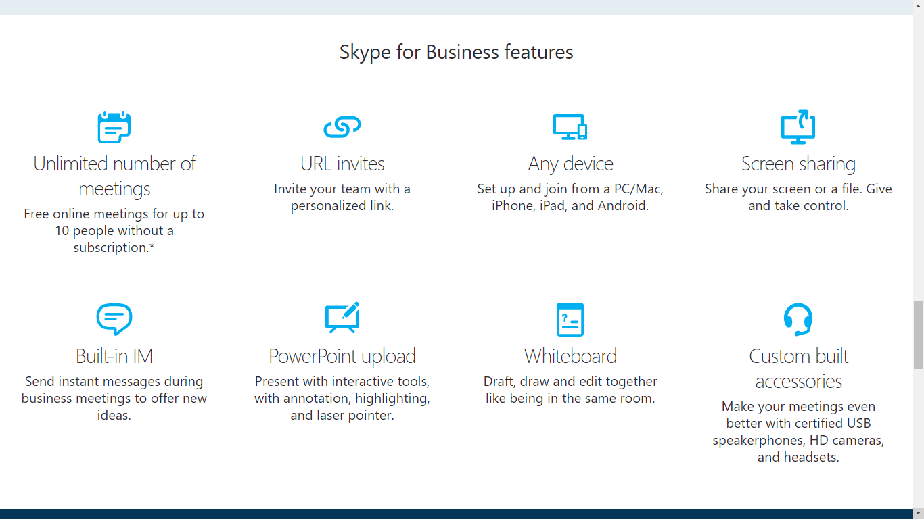
Skype

Slide 80
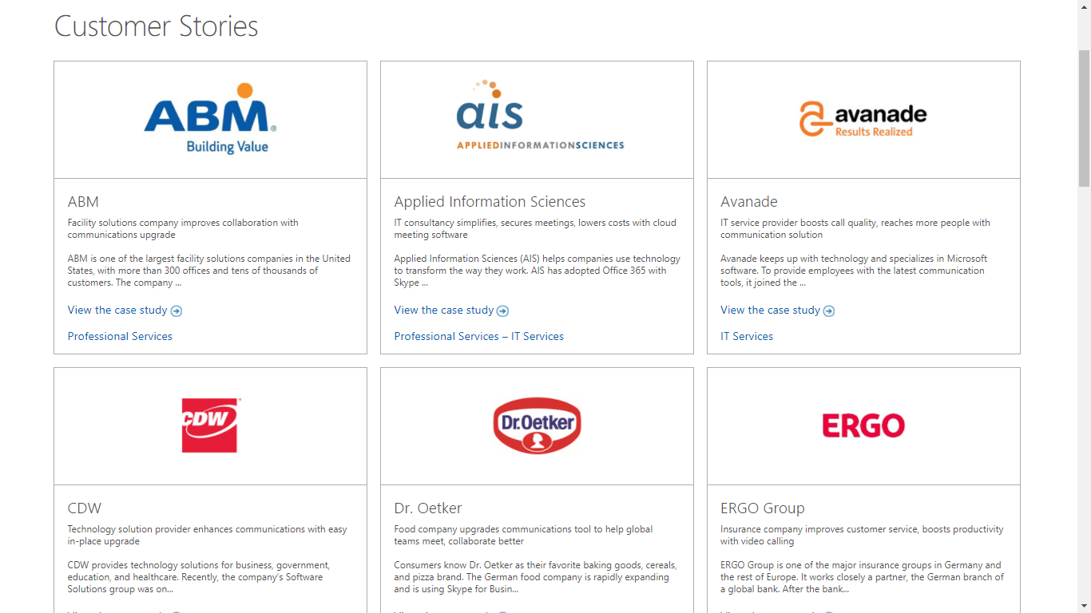
Skype

Slide 81
Skype
Awards
In September 2005, eBay acquired Skype for $2.6 billion.
Microsoft bought Skype in May 2011 for $8.5 billion.
Group B comment:
Skype is probably the most popular video call service in the market, with good performance.

Slide 82

Glip
Website:
www.glip.com
History:
In June 2015, RingCentral acquired Glip. Glip was acquired by RingCentral for an undisclosed amount.
Mobile support:
iOS
Android
Logo

Slide 83
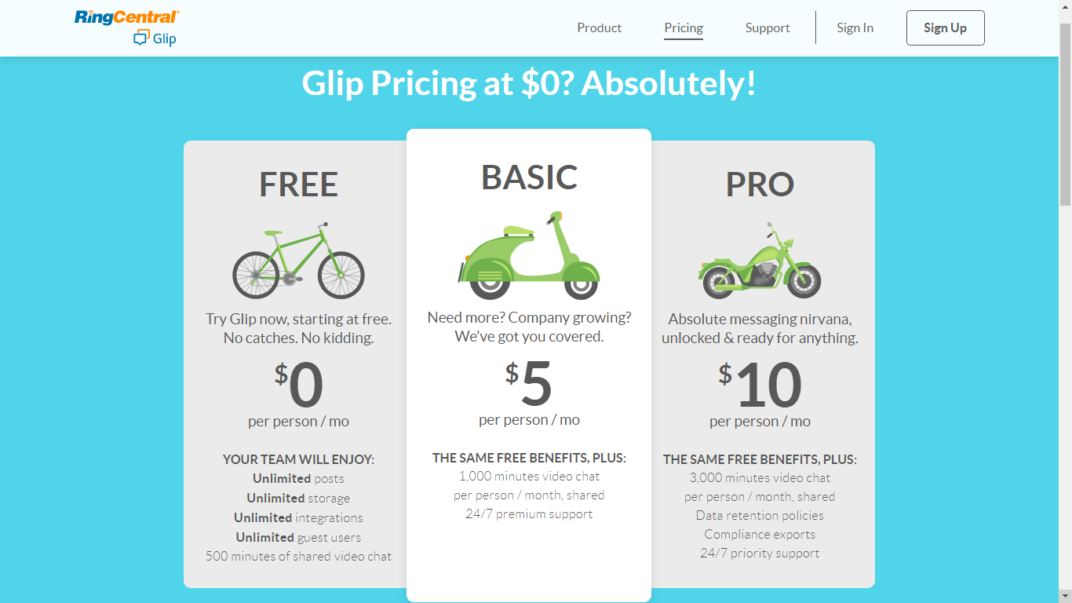
Prices / Versions

Slide 84
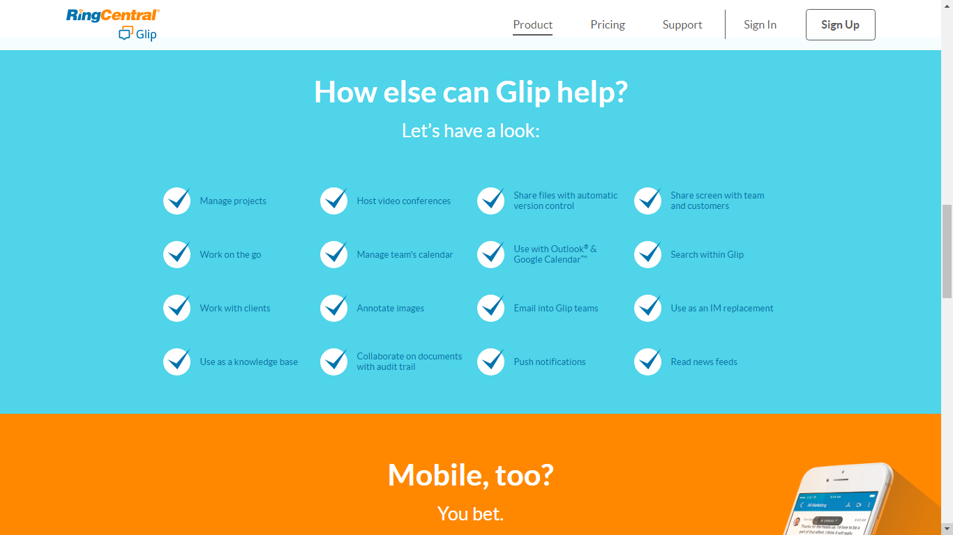
Features

Slide 85
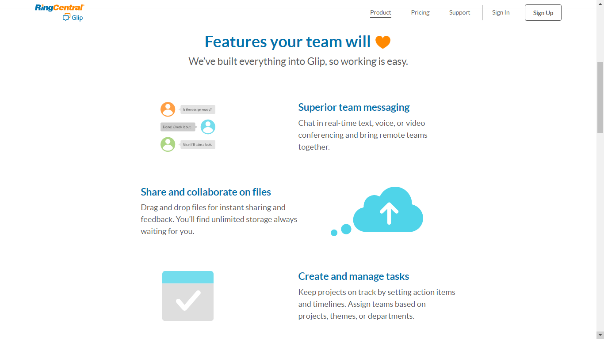

Slide 86
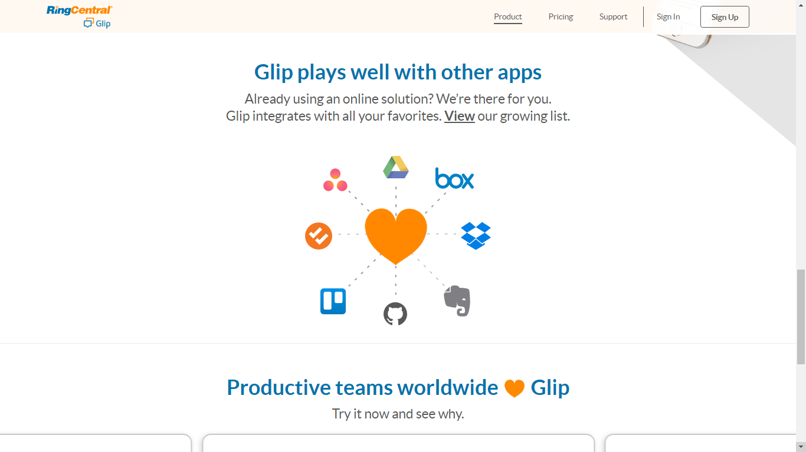
Integration

Slide 87
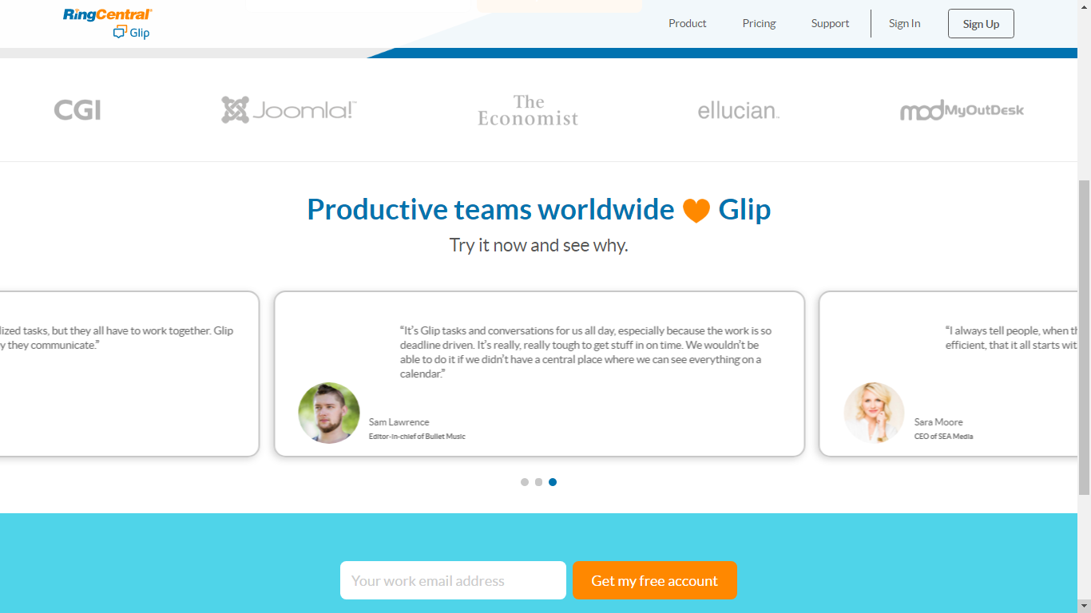
Integration

Slide 88
Glip
Awards:
RingCentral was identified as one of Forbes’ 100 Most Trustworthy Companies in America for 2016 and 2017.
Group B comment:
Glip is not just a team communication service, it also manage project, task, sharing screens.

Slide 89
 | Slack | Skype | Glip
Price | Free + Pay | Free + Pay | Free + Pay
Mobile app | Android, iOS | Android, iOS | Android, iOS
Traits – Some Features | Very good team communication service (group video chat) High performance web-based app Many good features (find, channel, code snippet, file sharing) App directory (excellent integration) | Very popular video call service (group video chat) More simplicity Direct phone calling Many companies using Skype For Business service | Powerful team communication service (group video chat) Native support for Task Management, Project management,… File sharing Integration

Slide 90
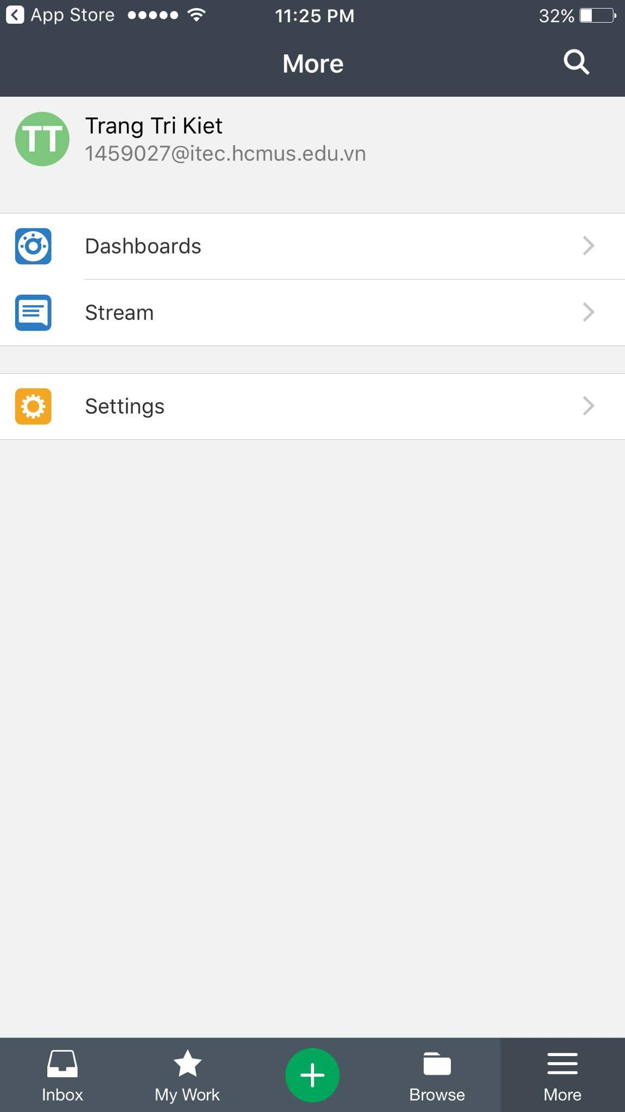

Wrike Mobile app

Slide 91


Wrike Mobile app

Slide 92


Wrike Mobile app

Slide 93

Wrike Mobile app

Slide 94


Trello Mobile app

Slide 95
Trello Mobile app

Slide 96

Trello Mobile app

Slide 97

Trello Mobile app

Slide 98

Trello Mobile app

Slide 99

Trello Mobile app

Slide 100


Slack Mobile app

Slide 101


Slack Mobile app

Slide 102

Slack Mobile app

Slide 103
Slack Mobile app

Slide 104
Video tìm hiểu về Wrike

Slide 105
Video tìm hiểu về Trello

Slide 106
Video tìm hiểu về Slack

Slide 107


Slide 108


